Slide 1
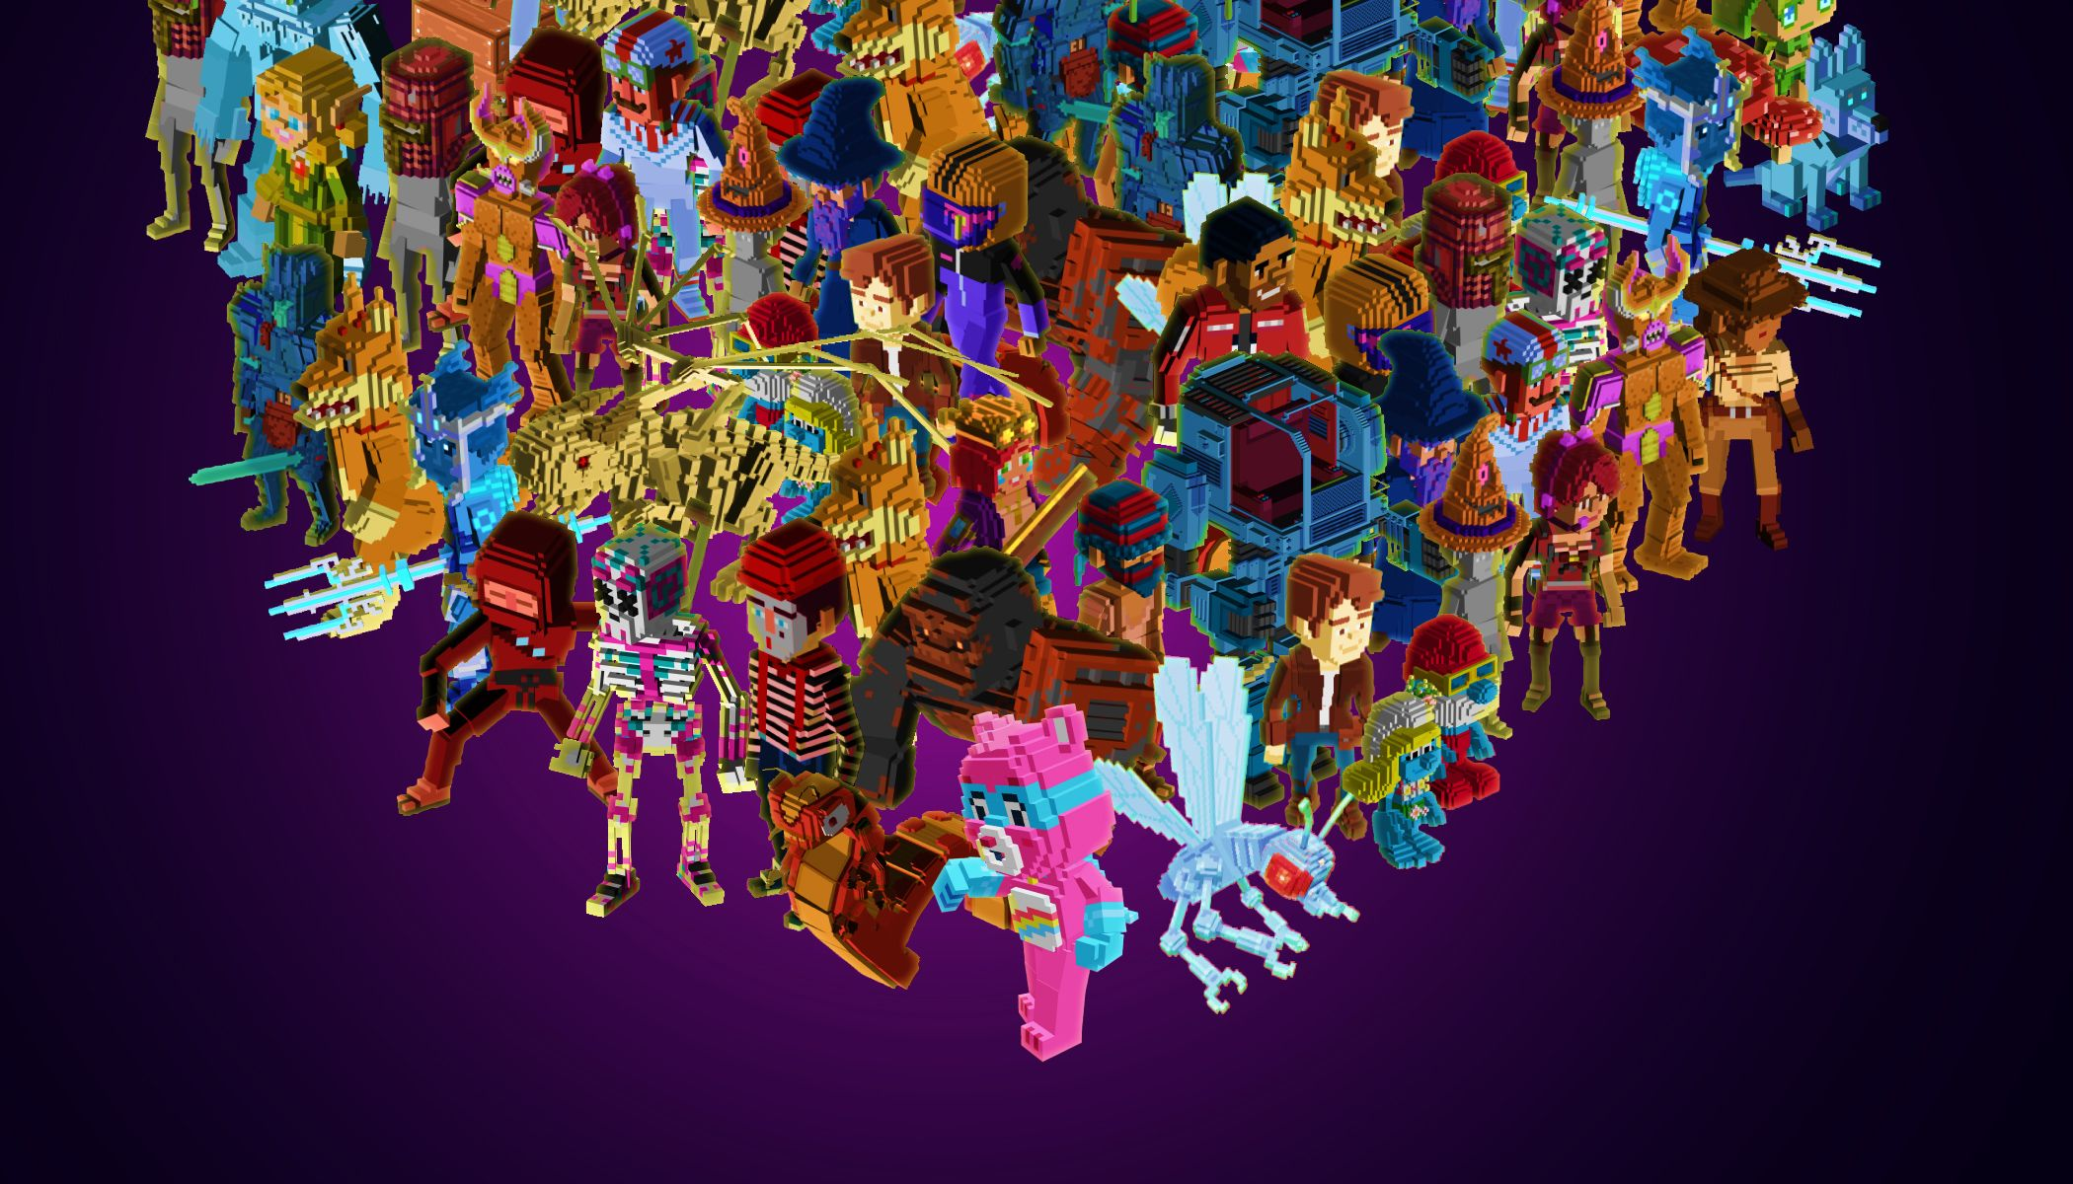
Team 8
NFT Robo predictor

Slide 2

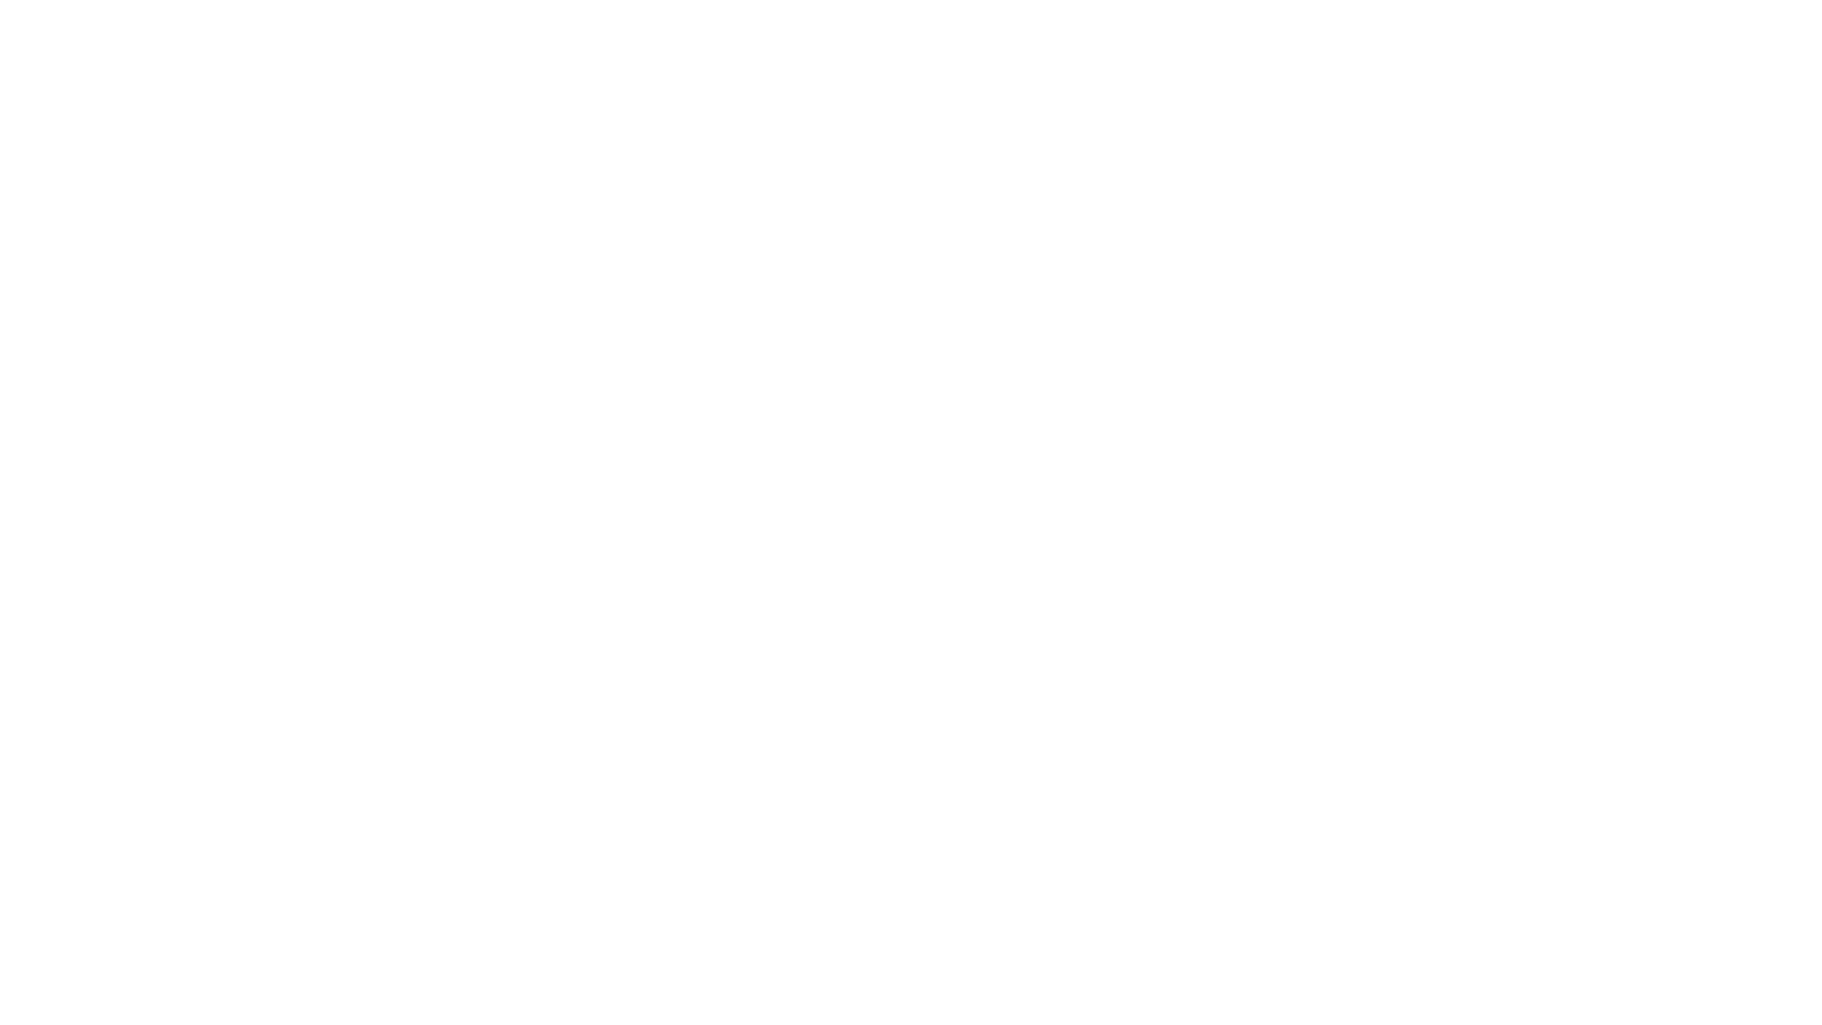
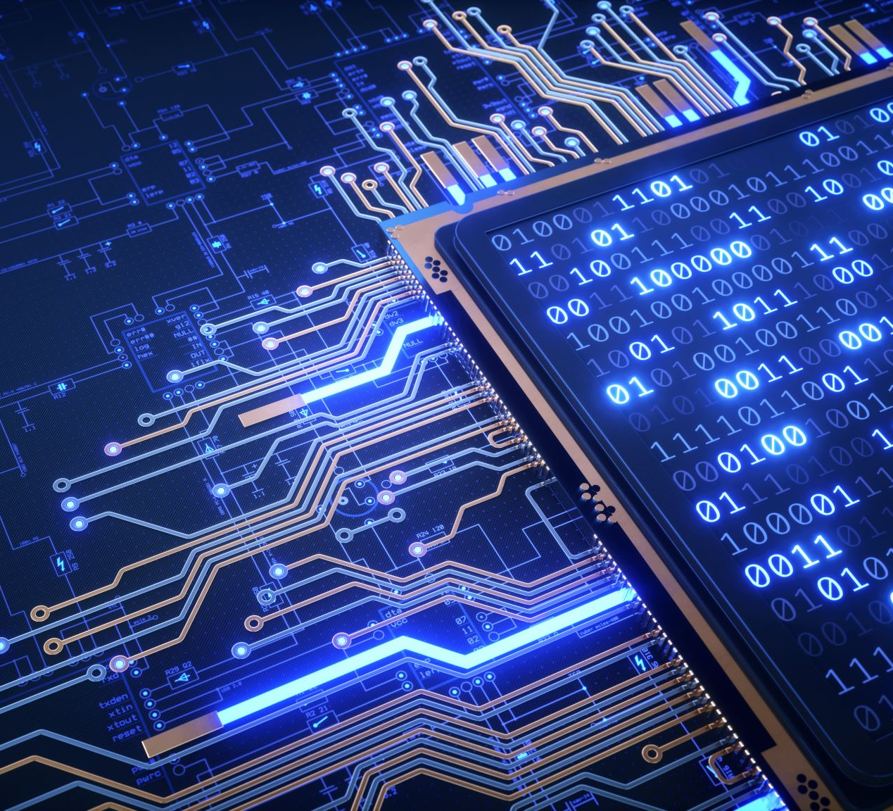
Project
NFT Robo Predictor
Project Objectives
App that analyses trends in NFT (Non-Fungible Token) market
Use of machine learning to predict future NFTs and their value
Auto-generation of new valuable NFTs
Team 8 Members
Charles Twitchell
Robert Giannini
George Kraft

Slide 3
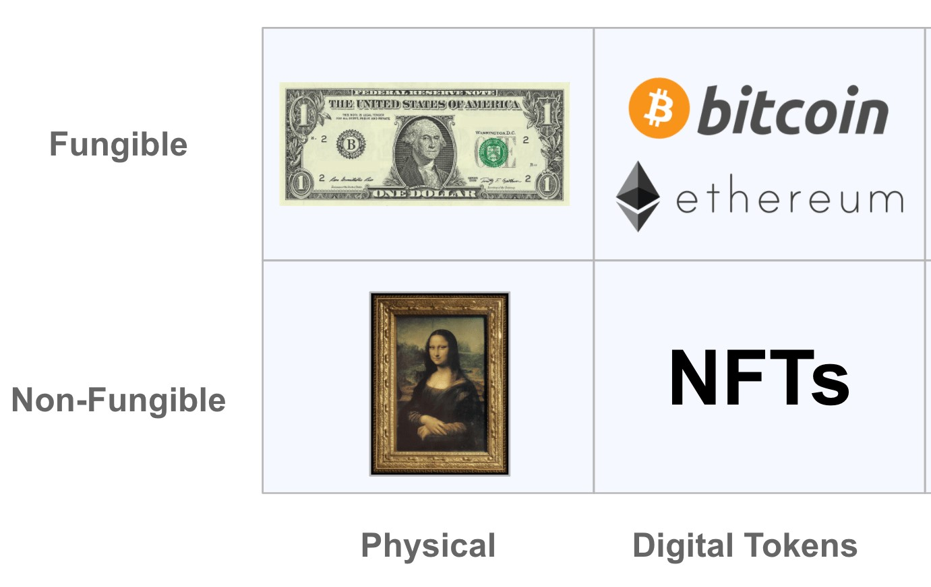
What is a NFT?
A non-fungible token (NFT) is a unique unit of data or one-of-a-kind piece of code, stored and protected on a blockchain (e.g. Ethereum) and is not mutually interchangeable, i.e. non-fungible
One bitcoin is indistinguishable from any other bitcoin and can be readily exchanged, i.e. fungible

Slide 4
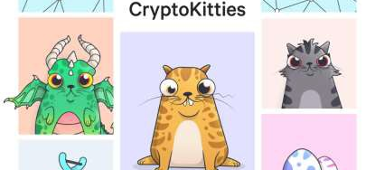
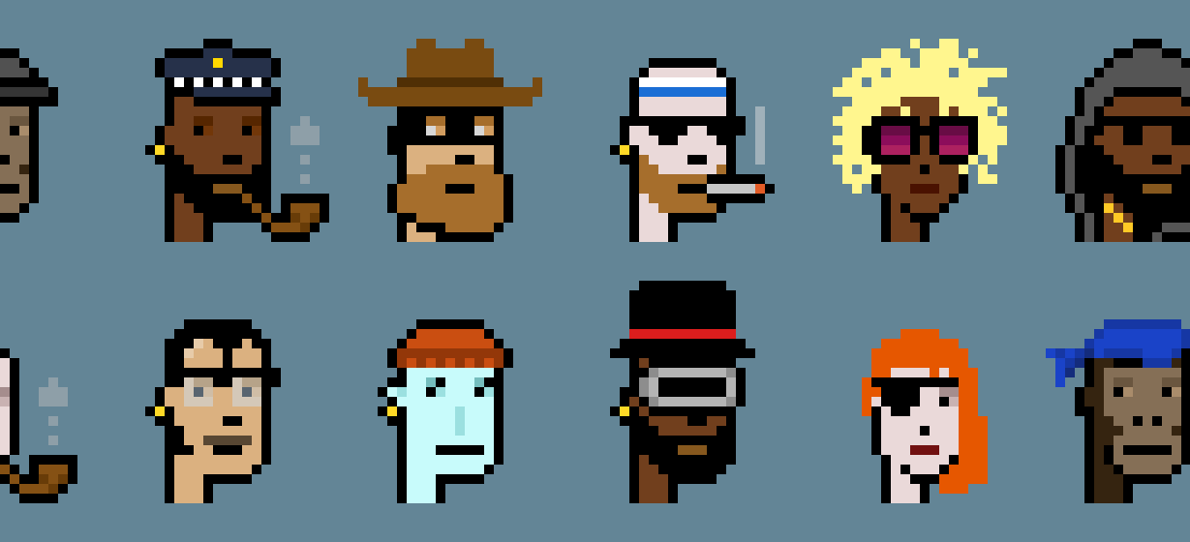
What does an NFT represent?
An NFT can represent anything that exists as a digital asset or as a physical item
NFT representing ownership of a digital asset resides in a digital wallet
Very few restrictions as to what kind of content can be "tokenized" and turned into an NFT

Slide 5
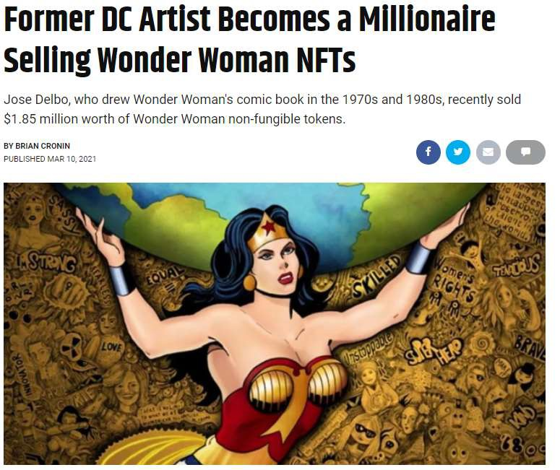
NFTs can be of significant value

Slide 6

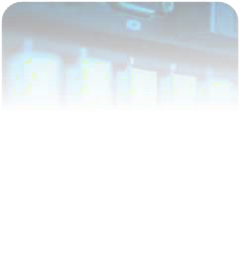
What do you get from an NFT?
NFTs provide:
A way to authenticate ownership
Permanency
Blockchain recorded originality
Distinction between NFT and copies of underlying digital asset:
It is possible to have more than one NFT representing different copies of an identical piece of digital art or image but the code or token for each copy is unique

Slide 7
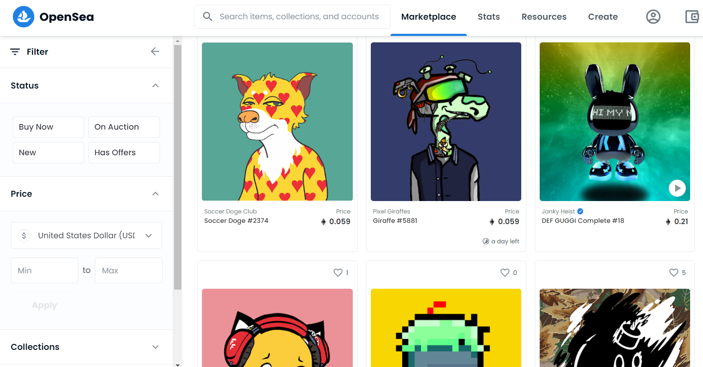
Opensea NFT Marketplace
The world’s first and largest digital marketplace for crypto collectibles and non-fungible tokens (NFTs) to buy, sell, and discover exclusive digital assets

Slide 8
Title
Describe approach:
Used OpenSea API to download NFT dataframe with characteristic variables (e.g. traits) and associated sale price
Prepared data and split into training and testing datasets
Used machine learning to predict sale price based on historical NFT variables

